Slide 1
The Relationship Between Population Density and Economic Factors in US Counties
Oliver Einarsson, Gina Fender, Morgen Henry, Ryan Krause, & Mark Speers
Notes:
Hello! Our names are Oliver Einarsson, Gina Fender, Morgen Henry, Ryan Krause, and Mark Speers. Today, we will be discussing our search for a relationship between population density and individual economic factors of counties within the United States.

Slide 2
Economic Factors Considered
Cost of Living
Household Income
Income per Capita
Education Rates
Notes:
For this analysis, we considered the following economic factors:
Cost of living, or the amount of money required to cover necessary expenses to maintain a certain lifestyle standard in a particular place and time. For this project, we will be representing this factor through one variable: the median rent of a county.
Income per Capita, or the total income of a county divided by every single person that resides within that county, even including newborns.
Household income is the income of all members of a common address, above a specified age, on average within a county.
For this project, we are defining Education Levels as the percentage of people who achieve different degrees of higher education (ie. Bachelor's, Master's, etc.).

Slide 3
PRIMARY GOAL
Determine if it is a better financial decision to live in a densely or sparsely populated county when choosing a place to live in the United States.
Notes:
Imagine you are looking to move to a new county and ask yourself 'can I afford to live somewhere densely populated". This investigation should inform the audience if it would be a more financially sound decision to move to a densely or sparsely populated county.

Slide 4
Benefit of investigating this Relationship
Are most counties in the US densely or sparsely populated?
Are most counties in the US similar in size?
Does it cost more to live in a densely populated county?
Do workers in densely populated counties have a higher income?
What highest level of education is most common in dense versus sparse counties?
Do you need to have a high level of education to have a high income in highly populated counties?
Notes:
By understanding the relationship between population density and these factors, we can gain better insight into questions such as the following: (questions on slide)

Slide 5
Data Collection & Clean up
Data Sources
Data Clean Up
US County Level Census:
https://www.ers.usda.gov/data-products/county-level-data-sets/
Issue Experienced: When using this site, it is MUCH easier to use if the census wrapper is used as well.
Department of Agriculture Website
https://www.ers.usda.gov/data-products/county-level-data-sets/
Data was retrieved from these APIs and merged to create a single census data frame.
Issue Experienced: When attempting to merge this data, our resulting data frame had many "NaN" values added in. We found that this was due to different lengths of the datasets and adjusted our merge method to correct for this.
Notes:
Our Data Source for this project was the US (year) Census reported by county. This source can be somewhat difficult to interpret if not used in tandem with the Census wrapper, which we have previously used in class.
We then merged this data into a single data frame to reference while creating our visuals. Though pulling data from the same base, we encountered an issue where our data frames were not the same length, we needed to change our merge method in order to properly create this set.

Slide 6
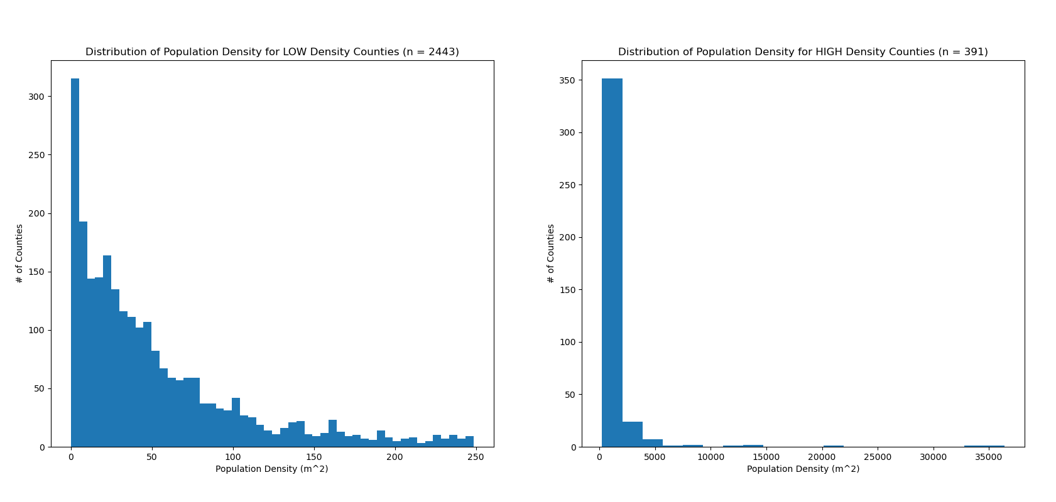
Population Density
Figure 1: Histograms of Population Density
Notes:
Here we show the number of counties with high and low population density.
You may notice that this graph is split into two groups. This is because the majority of counties have a relatively low population density, resulting in very negatively skewed data. We decided to separate this data into two groups, counties with a density of less than 250 people per square mile and counties with a density greater than 250 people per square mile.

Slide 7
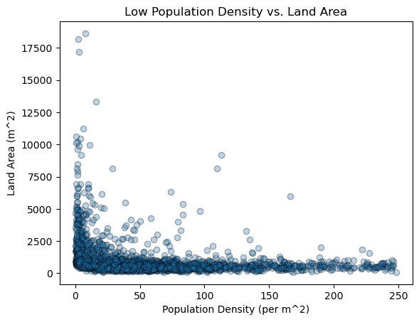
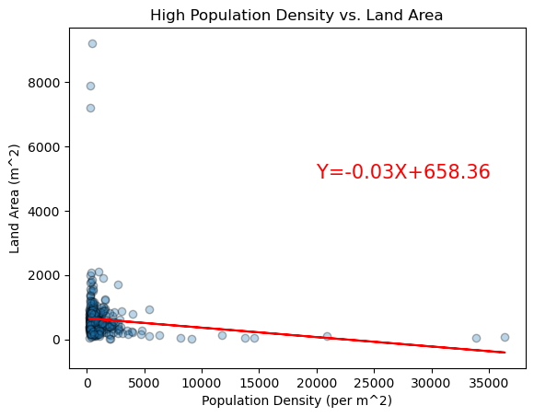
Land Area
Figure 2: Scatter plots of Population Density vs. Land Area (by square mile)
Notes:
For counties with low population densities, we do not see a relationship between population density and land area. However, for densely populated counties, as population density increases, the land area decreases. This is a negative correlation. These counties most likely contain cities where there are many residents in a small amount of space.

Slide 8
Cost of Living
Figure 3: Scatter plots of Population Density vs. Median Rent
Notes:
How much will it cost to survive here?

Slide 9
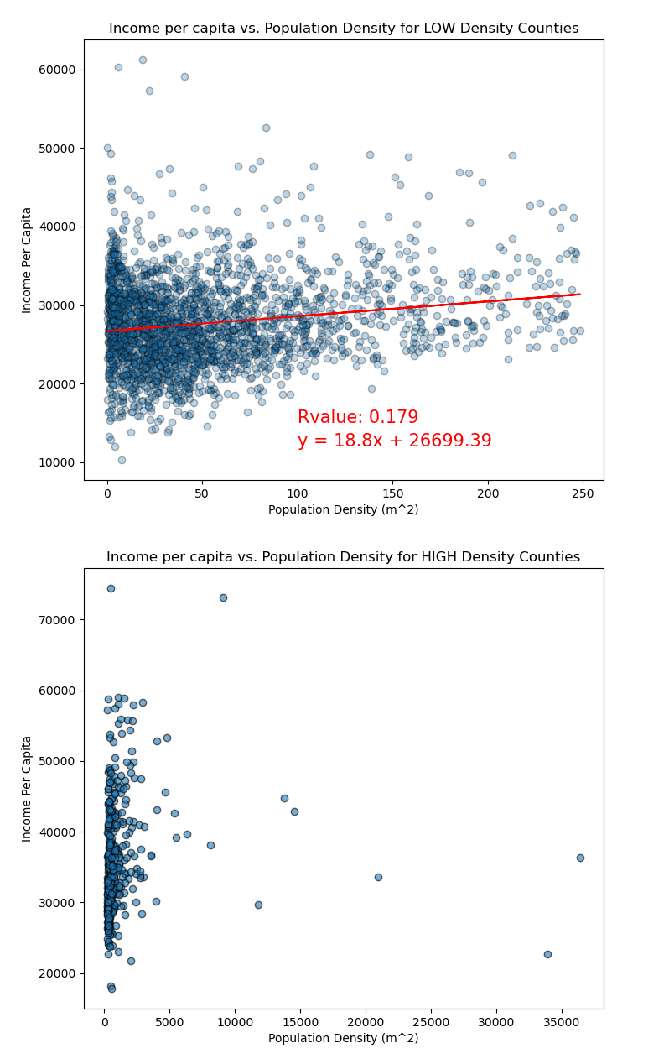

Income per Capita
Subsequent T-test
Figure 4: Scatter plots of Population Density vs. Income per Capita
Notes:
Is there higher income per resident

Slide 10
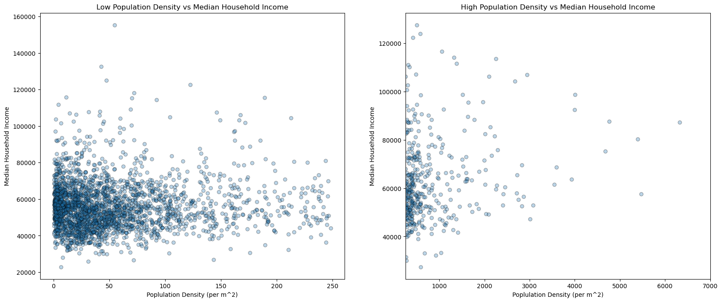
Median Household Income
Figure 5: Scatter plots of Population Density vs. Median Household Income
Notes:
If not, is this because the labor force can't find work?

Slide 11
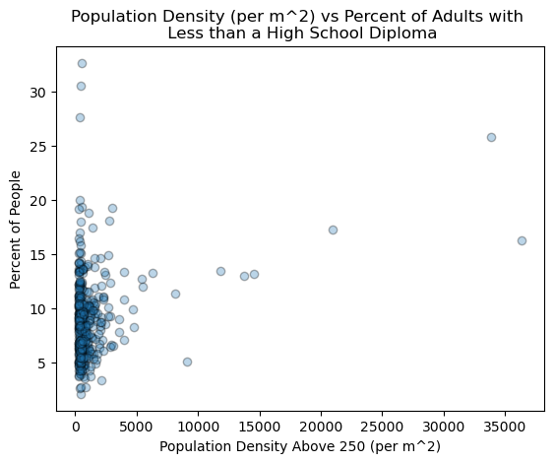
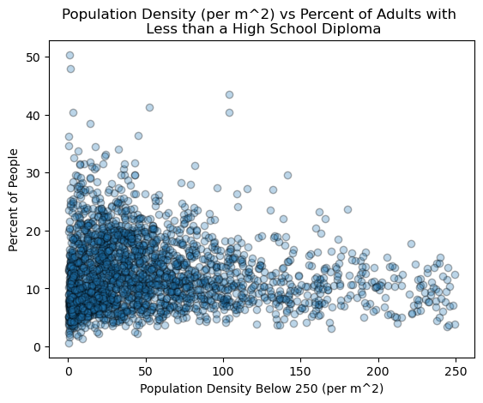
Education – Less than High School Degree
Figure 6: Scatter plots of Population Density vs. Percent of People with Less than a High School Degree
Notes:
In counties with low population density, we see a slight negative correlation between population density and percent of people with less than a high school degree.
In counties with high population density, we see a weak positive correlation between population density and percent of people with less than a high school degree.

Slide 12
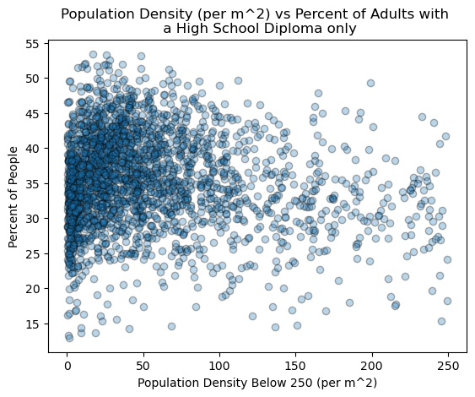
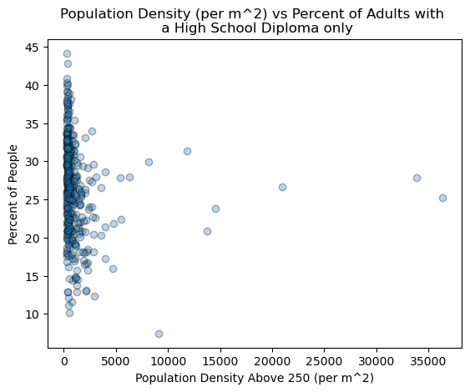
Education – High School Degree
Figure 7: Scatter plots of Population Density vs. Percent of People with Only a High School Degree
Notes:
In counties with low population density, we see a weak negative correlation between population density and percent of people with only a high school degree.
In counties with high population density, we see a weak negative correlation between population density and percent of people with only a high school degree.

Slide 13
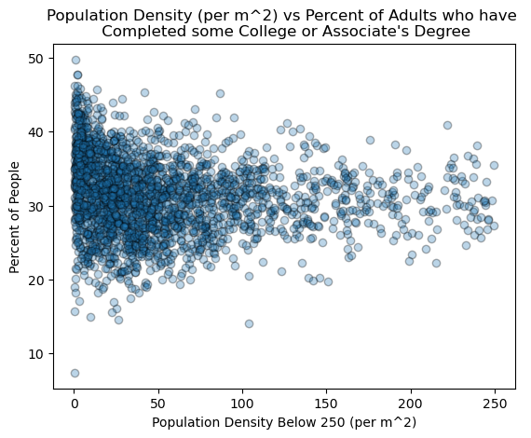
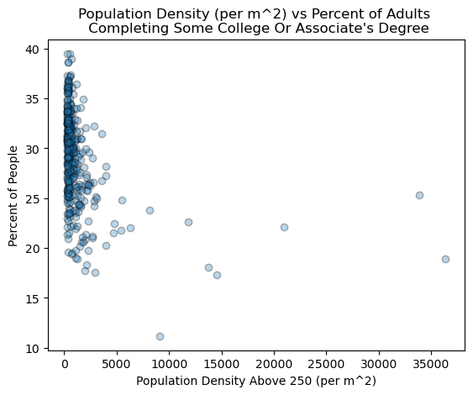
Education – Some College/Associate's Degree
Figure 8: Scatter plots of Population Density vs. Number of People with Some College/Associate's Degree
Notes:
In counties with low population density, we see a weak negative correlation between population density and percent of people with some college or an associate's degree.
In counties with high population density, we see a somewhat weak negative correlation between population density and percent of people with some college or an associate's degree.

Slide 14
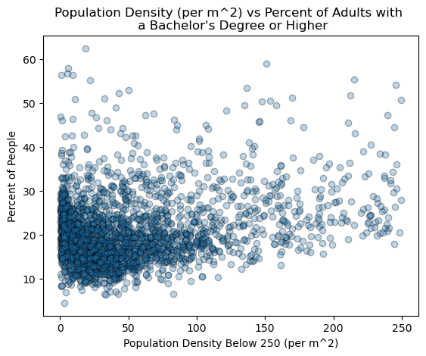
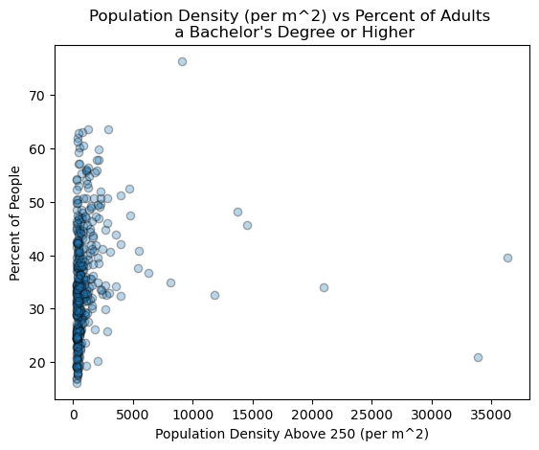
Education – Bachelor's Degree or Higher
Figure 9: Scatter plots of Population Density vs. Percent of People with a Bachelor's Degree or Higher
Notes:
In counties with low population density, we see a weak positive correlation between population density and percent of people with a Bachelor's or higher degree.
In counties with high population density, we see a weak positive correlation between population density and percent of people with a Bachelor's or higher degree.

Slide 15
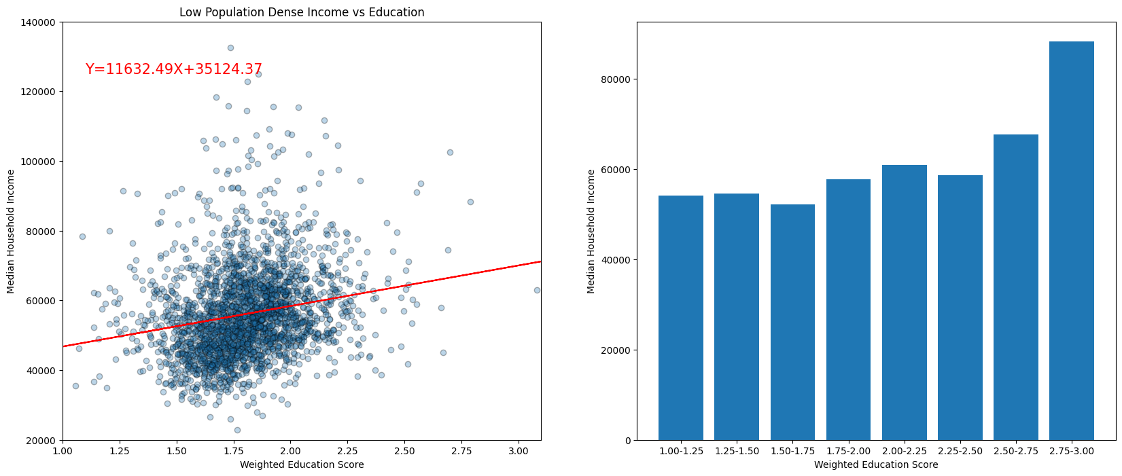
Education Vs. Income in Sparsely Populated Counties
Figure 6: Scatter plots of Number of People with Higher Education vs. Median Household Income
Notes:
In sparsely populated counties, we found a weak positive correlation between education level and median household income. This may mean that having a higher level of education results in a greater income or that a greater income provides more opportunities to achieve higher education.

Slide 16
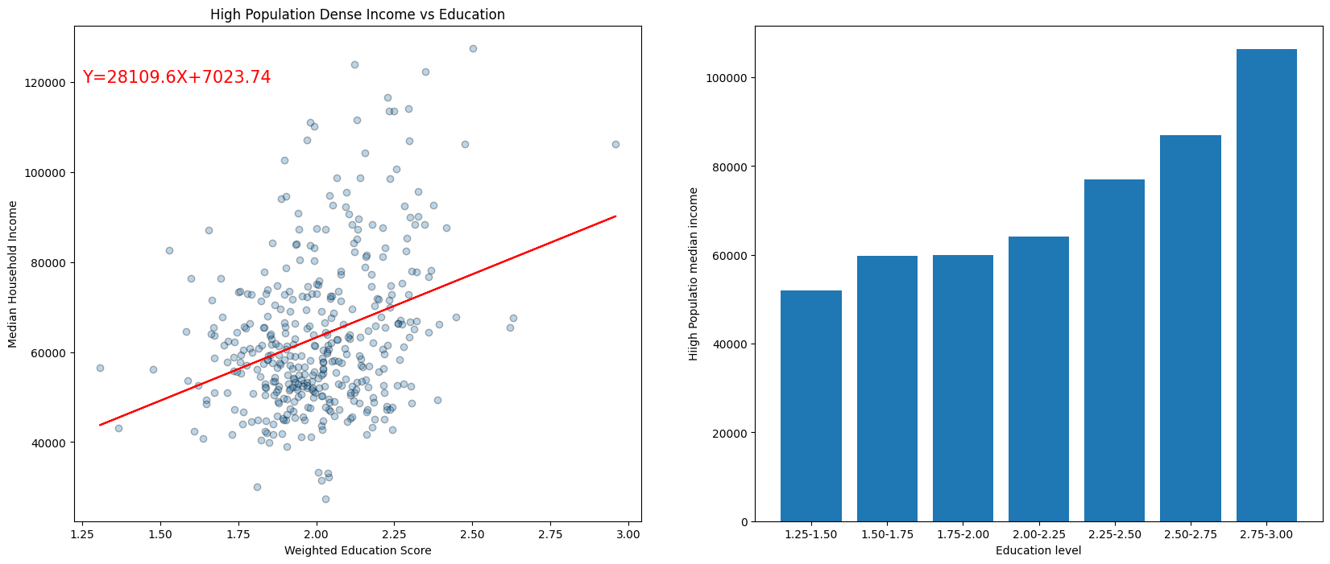
Education Vs. Income in Densely Populated Counties
Figure 6: Scatter plots of Number of People with Higher Education vs. Median Household Income
Notes:
In densely populated counties, we found a positive correlation between education level and median household income. This may mean that having a higher level of education results in a greater income or that a greater income provides more opportunities to achieve higher education.

Slide 17
Significant Relationships
Low Population
Sig Factor 2
Sig Factor 3
Readdress what the statistical relationship we found between pop density and this factor.
Readdress what the statistical relationship we found between pop density and this factor.
Readdress what the statistical relationship we found between pop density and this factor.

Slide 18
ANalysis Summary
One sentence summarizing finding
More detail about finding

Slide 19
THANK YOU for Your Attention

